Slide 1
@addTagHelper
The @addTagHelper directive makes Tag Helpers available to the view. In this case, the view file is Pages/_ViewImports.cshtml, which by default is inherited by all files in the Pages folder and subfolders; making Tag Helpers available. The code above uses the wildcard syntax ("*") to specify that all Tag Helpers in the specified assembly (Microsoft.AspNetCore.Mvc.TagHelpers) will be available to every view file in the Views directory or subdirectory. The first parameter after @addTagHelper specifies the Tag Helpers to load (we are using "*" for all Tag Helpers), and the second parameter "Microsoft.AspNetCore.Mvc.TagHelpers" specifies the assembly containing the Tag Helpers. Microsoft.AspNetCore.Mvc.TagHelpers is the assembly for the built-in ASP.NET Core Tag Helpers.

Slide 2
Steps to do the MVC CRUD with Entity
Create Poco Class
Create AppDbcontext class which is child of DbContext class
Create interface with CRUD method
Create Service class which will implement interface. In this class inject child of DbContext class reference
Implement CRUD methods
Put connection string in the appsettings.json file
Configure services in program.cs file
Add-Migeration and update-Database
Add controller with read write action and modify code. Call method of service class
Write click on Action method and generate views.[list,details,delete,edit]

Slide 3
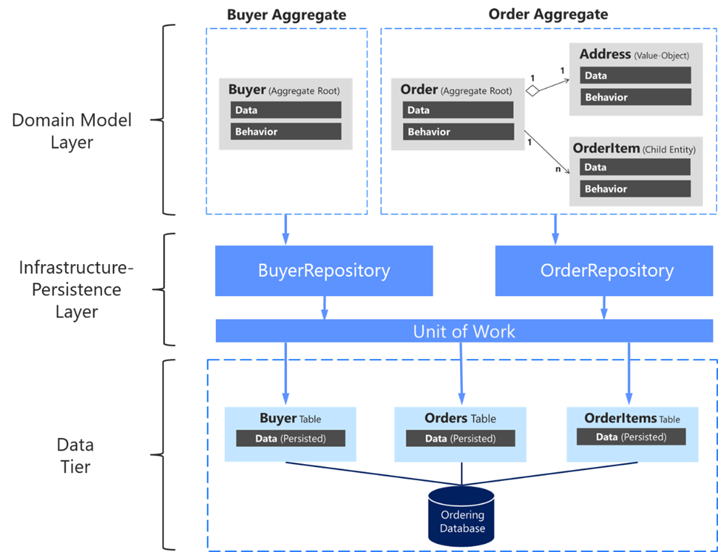
What is repository design pattern
The Repository pattern is a Domain-Driven Design pattern intended to keep persistence concerns outside of the system's domain mode
What is the function of repository pattern?
The repository pattern is a design pattern that isolates the data layer from the rest of the app.
The data layer refers to the part of your app, separate from the UI, that handles the app's data and business logic, exposing consistent APIs for the rest of your app to access this data.

Slide 4
In Models Folder Create Poco class
using System.ComponentModel.DataAnnotations;
public class Employee
{
public int Id { get; set; }
[MaxLength(50, ErrorMessage = "Name cannot exceed 50 characters")]
public string Name { get; set; }
[Display(Name = "Office Email")]
[RegularExpression(@"^[a-zA-Z0-9_.+-]+@[a-zA-Z0-9-]+\.[a-zA-Z0-9-.]+$",
ErrorMessage = "Invalid email format")]
public string Email { get; set; }
public Dept? Department { get; set; }
}
public enum Dept
{ HR,
Payroll,
IT
}
Server Side Validation

Slide 5
In Models Folder Create Interface and Repository class
public class MockEmployeeRepository:IEmployeeRepository
{
private static List<Employee> _employeeList;
public MockEmployeeRepository()
{
_employeeList = new List<Employee>(){
new Employee() { Id = 1, Name = "Mary", Department = Dept.HR, Email = "mary@CDACtech.com" },
new Employee() { Id = 2, Name = "John", Department = Dept.IT, Email = "john@CDACtech.com" },
new Employee() { Id = 3, Name = "Sam", Department = Dept.IT, Email = "sam@CDACtech.com" },
};
}
public Employee Add(Employee employee)
{
employee.Id = _employeeList.Max(e => e.Id) + 1;
_employeeList.Add(employee);
return employee;
}
public Employee Delete(int Id)
{
Employee employee = _employeeList.FirstOrDefault(e => e.Id == Id);
if (employee != null)
{
_employeeList.Remove(employee);
}
return employee;
}
public IEnumerable<Employee> GetAllEmployee() {
return _employeeList;
}
public Employee GetEmployee(int Id)
{
return this._employeeList.FirstOrDefault(e => e.Id == Id);
}
public Employee Update(Employee employeeChanges)
{
Employee employee = _employeeList.FirstOrDefault(e => e.Id == employeeChanges.Id);
if (employee != null)
{
employee.Name = employeeChanges.Name;
employee.Email = employeeChanges.Email;
employee.Department = employeeChanges.Department;
}
return employee;
}
}
using System.Collections.Generic;
public interface IEmployeeRepository
{
Employee GetEmployee(int Id);
IEnumerable<Employee> GetAllEmployee();
Employee Add(Employee employee);
Employee Update(Employee employeeChanges);
Employee Delete(int Id);
}
Methods of List Class
LinQ
Returns the first element of a sequence, or a specified default value if the sequence contains no elements.
Default value for reference type is Null

Slide 6
using WebMVC01.Models;
namespace WebMVC01
{
public class Program
{
public static void Main(string[] args)
{
var builder = WebApplication.CreateBuilder(args);
// Add services to the container.
builder.Services.AddControllersWithViews();
var services = builder.Services;
services.AddSingleton< IEmployeeRepository, MockEmployeeRepository >();
// services.AddSingleton<IStudentRepository, TestStudentRepository>();
var app = builder.Build();
// Configure the HTTP request pipeline.
if (!app.Environment.IsDevelopment())
{
app.UseExceptionHandler("/Home/Error");
// The default HSTS value is 30 days. You may want to change this for production scenarios, see https://aka.ms/aspnetcore-hsts.
app.UseHsts();
}
app.UseHttpsRedirection();
app.UseStaticFiles();
app.UseRouting();
app.UseAuthorization();
app.MapControllerRoute(
name: "default",
pattern: "{controller=Home}/{action=Index}/{id?}");
app.Run();
}
}
}
Configuring service
Add Scoped :
When we register a type as Scoped, one instance is available throughout the application per request. When a new request comes in, the new instance is created. Add scoped specifies that a single object is available per request.

Slide 7
using Microsoft.AspNetCore.Http;
using Microsoft.AspNetCore.Mvc;
using Microsoft.VisualBasic;
using WebAppRepository.Models;
namespace WebAppRepository.Controllers
{
public class MyEmployeeController : Controller
{
// GET: Employee
IEmployeeRepository _emprp;
public MyEmployee(IEmployeeRepository emprp) {
_emprp = emprp;
}
public ActionResult Index()
{
return View(_emprp.GetAllEmployee());
}
// GET: Employee/Details/5
public ActionResult Details(int id)
{
return View(_emprp.GetEmployee(id));
}
// GET: Employee/Create
public ActionResult Create()
{
return View();
}
// POST: Employee/Create
[HttpPost]
[ValidateAntiForgeryToken]
public ActionResult Create(Employee empobj)
{
try
{
_emprp.Add(empobj);
return RedirectToAction(nameof(Index));
}
catch
{
return View();
}
}
// GET: Employee/Edit/5
public ActionResult Edit(int id)
{
return View(_emprp.GetEmployee(id));
}
// POST: Employee/Edit/5
[HttpPost]
[ValidateAntiForgeryToken]
public ActionResult Edit(int id, Employee empobj)
{
try
{
_emprp.Update(empobj);
return RedirectToAction(nameof(Index));
}
catch
{
return View();
}
}
// GET: Employee/Delete/5
public ActionResult Delete(int id)
{
return View(_emprp.GetEmployee(id));
}
// POST: Employee/Delete/5
[HttpPost]
[ValidateAntiForgeryToken]
public ActionResult Delete(int id, Employee empobj)
{
try
{
_emprp.Delete(id);
return RedirectToAction(nameof(Index));
}
catch
{
return View();
}
}
}
}
Constructor Injection
Using Interface reference we are calling method of a class
public class MockEmployeeRepository:IEmployeeRepository

Slide 8
To generate view
right click on index Action method
Click on add View[window will get open with View name Index]
In template dropdown list select List

Slide 9
Drop Down
<div class="form-group">
<select asp-for="Department"
asp-items="Html.GetEnumSelectList<Dept>()">
</select>
<label asp-for="Department" class="control-label"></label>
<input asp-for="Department" class="form-control" />
<span asp-validation-for="Department" class="text-danger"></span>
</div>
Open Index View
And modify the code
public class Employee
{ public int Id { get; set; }
[Required, MaxLength(50, ErrorMessage = "Name cannot exceed 50 characters")]
public string? Name { get; set; }
[Display(Name = "Office Email")]
[RegularExpression(@"^[a-zA-Z0-9_.+-]+@[a-zA-Z0-9-]+\.[a-zA-Z0-9-.]+$",
ErrorMessage = "Invalid email format")]
[Required]
public string? Email { get; set; }
[Required]
public Dept? Department { get; set; }
}
public enum Dept
{
HR,
Payroll,
IT
}
To Display Image
<img src="@Url.Content(item.Photo)" />

Slide 10
Add functionality to a view
public class HomeDetailslViewModel
{
public Employee Employee { get; set; }
public string PageTitle { get; set; }
}
public ActionResult Details(int id)
{
// Instantiate HomeDetailsViewModel and store Employee details and PageTitle
HomeDetailslViewModel homeDetailsViewModel = new HomeDetailslViewModel()
{ Employee = _employeeRepository.GetEmployee(id),
PageTitle = "Employee Details"
};
if (homeDetailsViewModel == null)
{ Response.StatusCode = 404;
return View("EmployeeNotFound", id);
}
// Pass the ViewModel object to the View() helper method
return View(homeDetailsViewModel);
}

Slide 11
https://learn.microsoft.com/en-us/aspnet/core/mvc/views/tag-helpers/intro?view=aspnetcore-7.0

